Slide 1
ELEMENTS OF COMMUNICATION SKILLS
WALEED AKRAM
20P-0640

Slide 2

INTRODUCTION FACE TO FACE COMMUNICATION PHYSICAL COMMUNICATION

Slide 3
INTRODUCTION Process of communication involves the steps taken to ensure successful communication. Communication process consist of necessary and interconnected elements. Basic communication elements of communication are >TONE OF VOICE >BODY LANGUAGE >WORDS

Slide 4
FACE TO FACE COMMUNICATION ALBERT MEHABIAN’S posted non- verbals aspects of communication great deal more than the words are spoken. You are most believable and most effectively communicating in face to face communication. Over half of the information we send to others is through non-verbal methods.

Slide 5
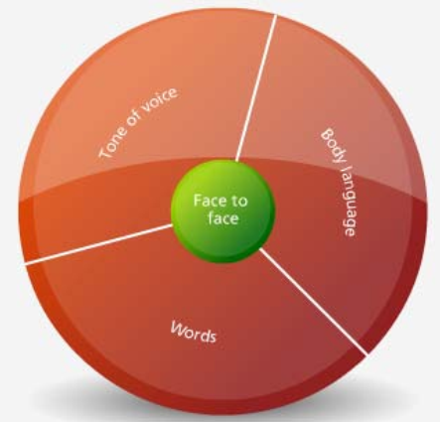
ELEMENTS OF FACE TO FACE COMMUNICATION TONE OF VOICE BODY LANGUAGE VERBAL COMMUNICTION

Slide 6
TONE OF VOICE The voice tones we use responsible about 35-40% of the messages we send. Tone involves The volume you use The level and type of emotion that you communicate The words you choose

Slide 7
BODY LANGUAGE Body language include: Facial expressions The way they are standing or sitting Gestures with their arms or hands Eye contact Breathing rate Swallowing or coughing Blushing Body language includes anything they are doing with their body besides speaking

Slide 8
VERBAL COMMUNICATION The third communication element is verbal communication. It is actually the least impactful element in face-to-face communication. Choosing our words carefully is a way to enhance our message the words we choose, to our best advantage. You would definitely make a different impression.

Slide 9

PHYSICAL COMMUNICATION There is one last element of communication that all of us use on a regular basis — physical communication. At work you might use it some — to pat someone on the back or to give them a slight tap on the shoulder to get their attention When it is used, it is more effective than verbal communication.

Slide 10
CONCLUSION : Verbal communication and non-verb communication both are important but I prefer verbal communication because verbal communication is fairly easy to decode if you understand language and pay attention.While non-verbal communication is a little harder .

